Slide 1


Object oriented programming with Java
Computer Science and Engineering

Slide 2


Chapter – 4
Arrays

Slide 3
Contents
Array
Array Values and Memory Storage Structure
Types of Arrays

Slide 4
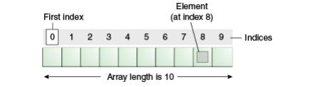
What is an Array?
An array is a container object that holds a fixed number of values of a single type. The length of an array is established when the array is created. After creation, its length is fixed.
Each item in an array is called an element, and each element is accessed by its numerical index. As shown in the preceding illustration, numbering begins with 0. The 9th element, for example, would therefore be accessed at index 8.

Slide 5
Arrays
In Java, Array is a group of like-typed variables referred to by a common name. Arrays in Java work differently than they do in C/C++.
Following are some important points about Java arrays.
Arrays in Java
In Java, all arrays are dynamically allocated.
Arrays may be stored in contiguous memory [consecutive memory locations].
Since arrays are objects in Java, we can find their length using the object property length.
This is different from C/C++, where we find length using sizeof.
A Java array variable can also be declared like other variables with [] after the data type.
The variables in the array are ordered, and each has an index beginning with 0.
Java array can also be used as a static field, a local variable, or a method parameter.

Slide 6
Arrays Values
In Java, an array value refers to the individual piece of data stored within an array. Each element in an array has:
Specific data type: All elements in an array must be of the same data type (e.g., int, double, String).
Unique index: Elements are accessed using their index, which is a zero-based integer position within the array. The first element has index 0, the second has index 1, and so on.

Slide 7
Arrays Values
1.Declaring the Array:
int[] numbers = new int[5];
Declares an array named numbers of type int (to store integers).
The size of the array is set to 5, meaning it can hold 5 integer values.
2.Initializing Array Elements:
numbers[0] = 10; (similarly for other elements)
numbers[0] refers to the first element (index 0) and is assigned the value 10.
This process continues for elements at indices 1, 2, 3, and 4.
3.Accessing and Printing Values:
The for loop iterates through the array using the index variable i.
numbers[i] accesses the value at the current index i within the loop.
System.out.print(numbers[i] + " "); prints the value followed by a space for better formatting.
Assigns values to individual elements.

Slide 8
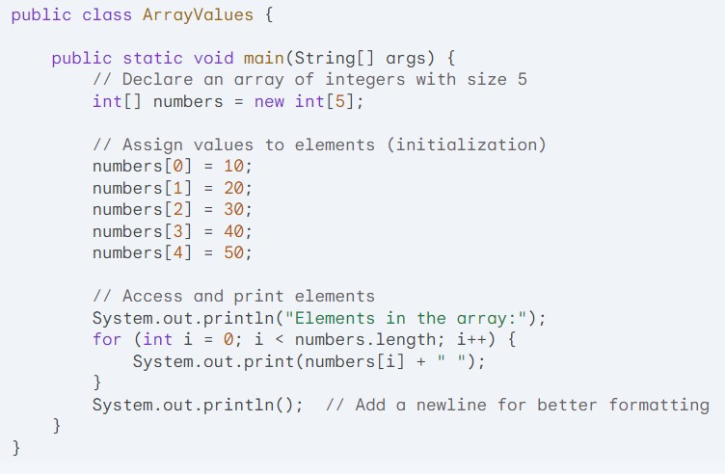
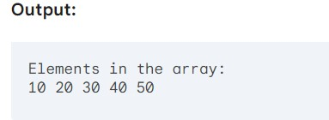
Arrays Values
Example:

Slide 9
Memory Structure of Arrays
Memory Structure of Arrays
When you declare an array in Java, two things happen:
Reference variable creation: A reference variable is created on the stack memory. This variable acts like a pointer, storing the memory address of the actual array object.
Array object creation: The actual array object is allocated in the heap memory. This object holds the following:
Length: The number of elements the array can hold.
Data: The actual elements of the array, each occupying the memory space required by its data type (e.g., 4 bytes for an int, 8 bytes for a double).

Slide 10
Memory Structure of Arrays
Example
int[] numbers = new int[5]; // Declare an array named 'numbers' of size 5 (int)
In this example:
numbers is a reference variable on the stack, initially containing null.
After new int[5], a new array object is created in the heap, capable of storing 5 integers. The memory address of this object is assigned to numbers.

Slide 11
Memory Structure of Arrays
Accessing Array Elements
Zero-based indexing: The first element has index 0, the second has index 1, and so on.
Accessing elements: arrayName[index]
Assigning values: arrayName[index] = value
Example:
numbers[0] = 10; // Assign 10 to the first element (index 0)
int value = numbers[2]; // Read the value at index 2

Slide 12
Types of Arrays
Types of Arrays in Java
Java primarily supports two main types of arrays:
Single-Dimensional Arrays
2.Multidimensional Arrays (Combination of single-dimensional arrays)

Slide 13
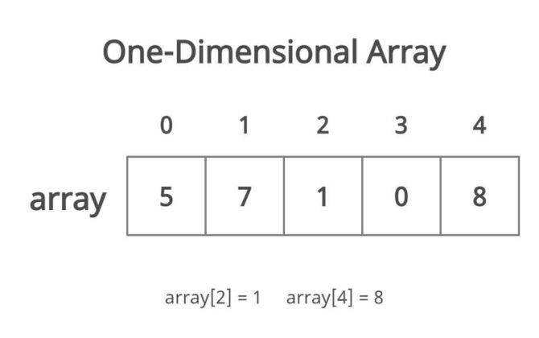
Single-Dimensional Arrays
1. Single-Dimensional Arrays
These arrays store a collection of elements of the same data type in a single row (linear fashion).

Slide 14
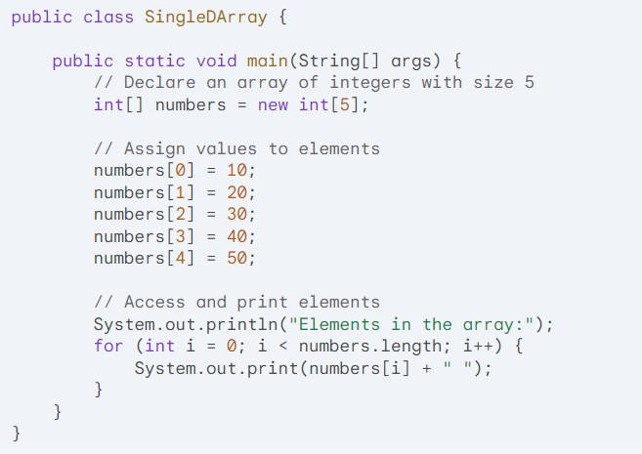
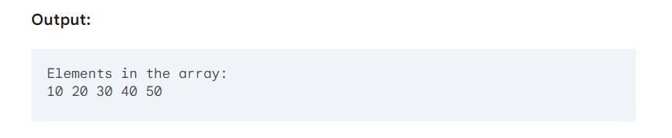
Single-Dimensional Arrays
Example:

Slide 15
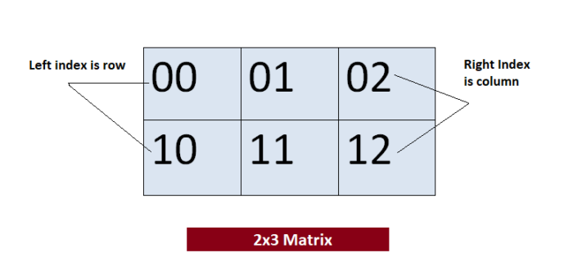
Multidimensional Arrays
Multidimensional Arrays
These arrays are essentially arrays of arrays. They store elements in a grid-like structure with rows and columns.

Slide 16
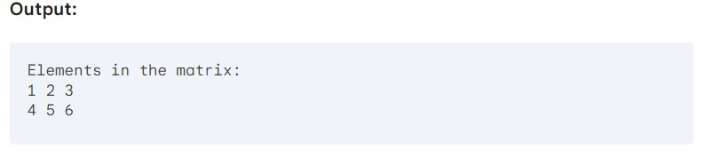
Multidimensional Arrays
Example:
public class MultiDArray {
public static void main(String[] args) {
// Declare a 2D array of integers with 2 rows and 3 columns
int[][] matrix = new int[2][3];
// Assign values to elements
matrix[0][0] = 1;
matrix[0][1] = 2;
matrix[0][2] = 3;
matrix[1][0] = 4;
matrix[1][1] = 5;
matrix[1][2] = 6;
// Access and print elements
System.out.println("Elements in the matrix:");
for (int i = 0; i < matrix.length; i++) { // Loop through rows
for (int j = 0; j < matrix[i].length; j++) { // Loop through columns of each row
System.out.print(matrix[i][j] + " ");
}
System.out.println(); // New line after each row
}
}
}

Slide 17
References
[1] https://www.geeksforgeeks.org/default-array-values-in-java/?ref=header_search
[2] https://www.javatpoint.com/array-in-java
[3] https://www.w3schools.com/java/java_arrays.asp
[4] https://courses.cs.duke.edu/summer07/cps001/Lectures/Lecture13.pdf
[5] https://youtu.be/zcq5WDHQ31g?si=9Z8LFpqiYqKhzTTV
[6] https://youtu.be/_udey-r43W0?si=TGlV1d9AEgwrWBLR
[7] https://medium.com/@f2015939p/array-memory-allocation-in-java-49b292122d18

Slide 18



